Slide 1


Database Management System – PBL
Campus Placement and Recruitment Drive Management System
by
Farhan Ansari AIML RHINOS 25WU0102074

Slide 2


Introduction
WH AT IS THE PR O JE C T?
The system maintains information about:
Students Companies
Job profiles Placement drives
Eligibility criteria Applications
Selection rounds Results Job offers
The Campus Placement and Recruitment Drive Management System is a database-based system designed to manage the complete campus placement process. It helps the placement cell manage student applications and recruitment activities in an organized, centralized manner.

Slide 3


Problem Identification
EXIS TING PR OB LEM
In many institutions, placement information may be managed using spreadsheets, documents or separate records. This can lead to:
Difficulty managing large numbers of students Duplicate or incorrect application records Difficulty checking eligibility
Difficulty tracking selection rounds
Difficulty maintaining company and job information Difficulty tracking final offers
Time-consuming report generation
PR OBLEM S TATEMENT
To develop a centralized database management system that efficiently manages students, companies, placement drives, eligibility, applications, selection rounds, results and offers.
The project specification also highlights that manual screening can result in ineligible students being considered.

Slide 4
Objectives
MAIN OB JE C TIVE S
1
Maintain a centralized database of student placement records
6
Track selection rounds and their results
2
Manage company and job profile information
7
Maintain records of placement offers
3
Manage placement drives efficiently
8
Generate useful placement-related reports
4
Check student eligibility for job opportunities
9
Reduce duplicate and incorrect data
5
Record student applications
10 Improve the efficiency of the placement process

Slide 5




Scope of the Project
THE S Y S TEM WILL C O VER
Student Management
Company Management
Student details
Department Academic records Skills
Company details
Job profiles
Eligibility requirements
Placement Management
Reporting
Placement drives
Applications Selection rounds Results
Offers
Eligible students
Applications
Selected students
Company-wise statistics
Offers

Slide 6
Literature Survey
EXIS TING APPR O A CHE S V S PR OPOSED S Y S TEM
Existing Approach | Limitations
Manual records | Time-consuming
Excel spreadsheets | Data duplication and inconsistency
Separate student/company records | Difficult to integrate
Manual eligibility checking | Possibility of errors
Manual report generation | Takes more time
PR OPOSED SYS TEM PR OVIDE S
Centralized data
Automated eligibility management Structured relationships
Faster searching Better data integrity Automated reports
C ONCLUSION
Existing approaches can manage basic placement information, but a centralized relational database can provide better organization, consistency and efficient retrieval of placement data.

Slide 7
Proposed System
S Y S TEM W ORKFL O W
Student Registration
→
Academic & Skill Details
→
Company & Job Profile
→
Placement Drive
→
Eligibility Check
↓
Student Application
→
Selection Rounds
→
Round Results
→
Final Selection
→
Job Offer
This slide explains the entire project in one ﬂow — from student registration through to the final job offer — and is well suited for verbal explanation during the review.

Slide 8



Users of the System
THREE TY PE S OF USER S
1
2
3
Placement Administrator
Student
Company / Recruiter
Manage students
View available drives
Provide company information
Manage companies
Check eligibility
Create job profiles
Create placement drives
Apply for drives
Define requirements
Define eligibility criteria
View application status
Conduct selection rounds
Manage selection rounds
View selection results
Provide results
View results
View offers
Submit offers
Generate reports

Slide 9
Functional Requirements
SR S — THE S Y S TEM SHOULD ALL O W
FR1
Admin can add, update and delete student information.
FR2
Admin can add and manage company information.
FR3
Companies/jobs can have eligibility requirements.
FR4
Admin can create placement drives.
FR5
System can check student eligibility.
FR6
Eligible students can apply for a placement drive.
FR7
System can maintain selection rounds.
FR8
Results of each round can be recorded.
FR9
Final selected students can be recorded.
FR10
Job offers can be stored.
FR11
Users can search placement information.
FR12
System can generate placement reports.

Slide 10



Non-Functional Requirements
QU ALITY AT TRIBUTE S OF THE S Y S TEM
1
2
3
Performance
Security
Reliability
The system should retrieve placement records efficiently.
Only authorized users should be able to modify important placement data.
The system should maintain accurate and consistent records.
4
5
6
Usability
Scalability
Data Integrity
The application should have a simple and easy-to-use interface.
The database should handle increasing students, companies and applications.
Primary keys, foreign keys and constraints should prevent invalid data.

Slide 11
Main Entities
C ORE ENTITI E S IDENTIFIED IN THE PR O JE C T S TATEMENT
Student
Department
Academic Record
Skill
Company
Job Profile
Placement Drive
Eligibility Criteria
Application
Selection Round
Result
Offer

Slide 12
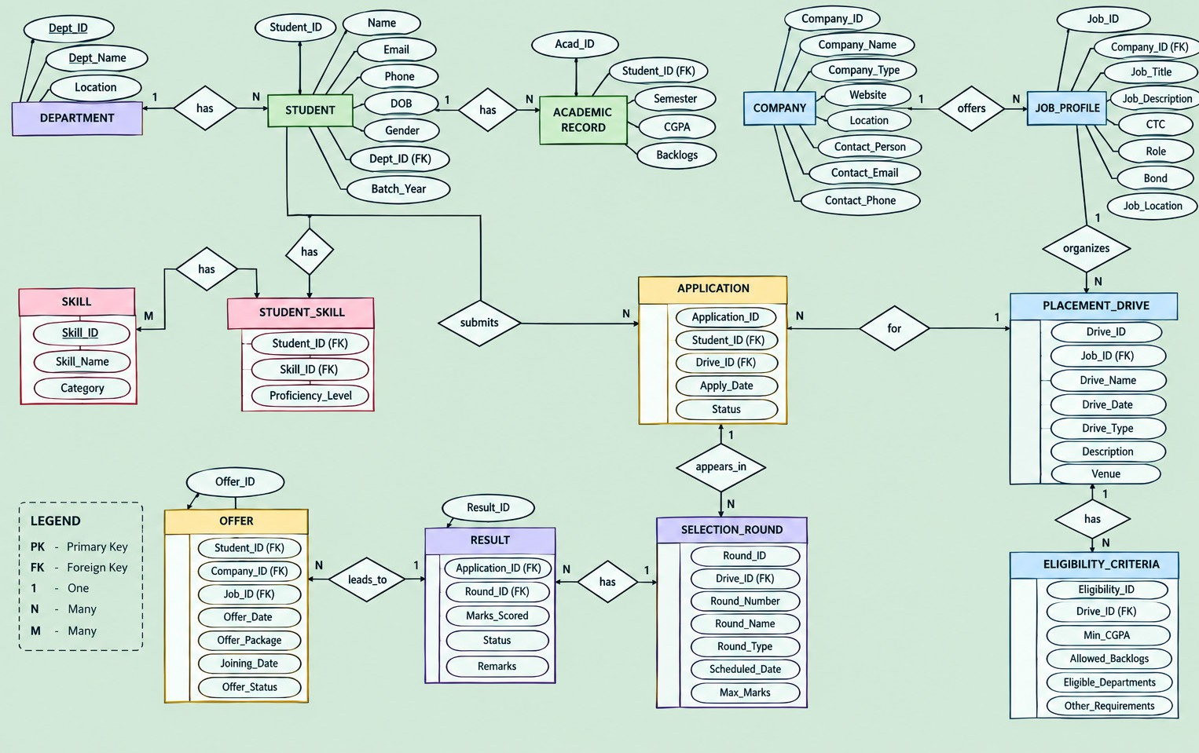
ER Diagram (Conceptual)
SIMPLIFIED C ONCEP TU AL S TRUC TURE

Slide 13
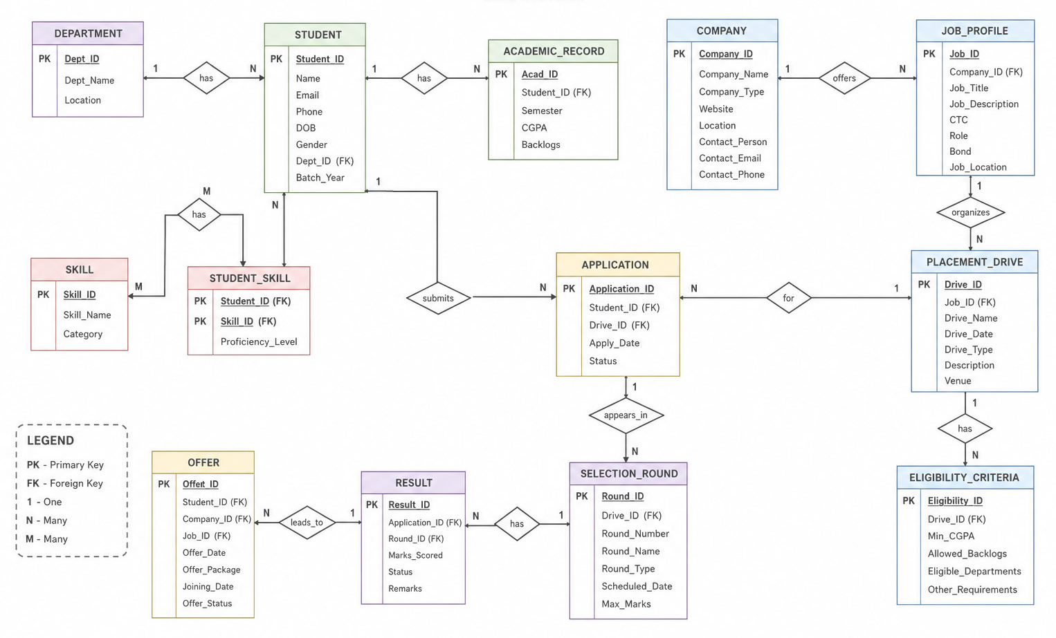
ER Diagram (structured)

Slide 14
PR OPOSED TAB LE S, KEY S AND REL AT IONSHIPS
Initial Relational Schema
STUDENT
DEPARTMENT
ACADEMIC_RECORD
SKILL
Student_ID (PK)
Academic_ID (PK) Student_ID (FK) CGPA
Year
Name Email Phone
Department_ID (FK)
Department_ID (PK)
Department_Name
Skill_ID (PK)
Skill_Name
COMPANY
JOB_PROFILE
PLACEMENT_DRIVE
ELIGIBILITY_CRITERIA
Company_ID (PK) Company_Name Location
Job_ID (PK) Company_ID (FK) Job_Title Package
Drive_ID (PK) Job_ID (FK) Drive_Date
Eligibility_ID (PK) Drive_ID (FK) Minimum_CGPA Eligible_Department
APPLICATION
SELECTION_ROUND
RESULT
OFFER
Application_ID (PK) Student_ID (FK) Drive_ID (FK) Application_Date Status
Round_ID (PK) Drive_ID (FK) Round_Name Round_Number
Result_ID (PK) Application_ID (FK) Round_ID (FK) Result_Status
Offer_ID (PK) Student_ID (FK) Company_ID (FK) Job_ID (FK) Offer_Date

Slide 15
Project Planning
FIVE PHASE S FR OM ANA LY SIS T O REPOR TING
1
2
3
4
5
Requirement Analysis
Database Design
Database Implementation
Application Development
Testing & Reporting
Identify users
ER diagram
Create tables
Develop Python app
Test database
Identify entities
Relational schema
Add constraints
Connect app with database
Test application
Identify requirements
Functional dependencies
Insert sample data
Implement CRUD operations
Generate reports
Define project scope
Normalization
Write SQL queries
Prepare documentation

Slide 16
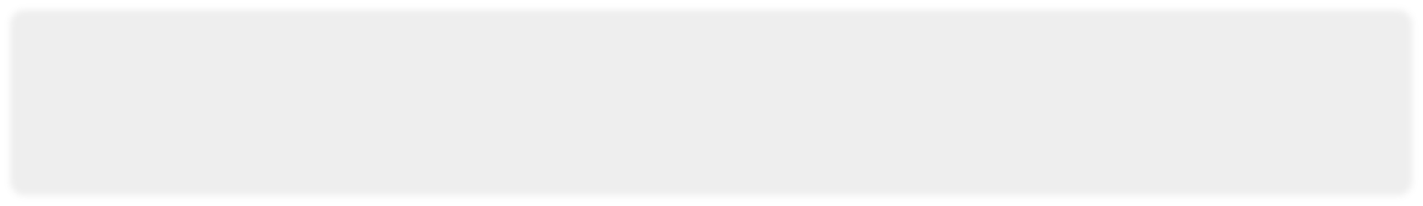
A centralized, structured system for campus recruitment
C ONCL USION
The Campus Placement and Recruitment Drive Management System reduces manual work, improves data consistency, helps identify eligible students and makes placement information easier to manage and retrieve.
Thank You
Farhan Ansari • AIML RHINOS • 25WU0102074

